Slide 1

hospital finder
Instructor: Nguyễn Đức Khoan
Members: Lê Phước Việt
Nguyễn Xuân Sơn

Slide 2
OBJECTIVES
Introduction
Current problem
Solution
Roles in the system
Technology
Algorithm
Boundary and Future improvement
Demo

Slide 3
INTRODUCTION
Hospital Finder is the system built for finding appropriate hospitals base on users’ conditions.
The results will be displayed on map.
Display hospital information, support rating, commenting and sharing through social account.

Slide 4
CURRENT PROBLEM
A system for finding appropriate health services base on patients’ conditions is not yet published.
Vietnam doesn’t have an official published list of hospitals and clinics that offer health services in the country.
A better list is supported by Google Map by using “Hospital” or “Health” keywords, but some locations and names are not relevant to health services because of attached advertising tag keywords.

Slide 5
HOSPITAL FINDER SYSTEM
Build for general users.
Provide 3 different types of search based on user’s needs.
Sort hospitals based on keywords, rating point and rating count numbers.
Provide a reliable list of hospitals in a specific area in Vietnam.

Slide 6
ROLES
Guest
Search hospital
View hospital information
Feedback
Normal User
Provided with services for guest
Create rating and comment

Slide 7
ROLES
Administrator
Manage hospital, user, meta data
View system feedback and statistic
Hospital User
Update hospital information
Manage doctor
View hospital feedback and statistic

Slide 8





TECHNOLOGY

Slide 9
ALGORITHMS
Geographic Information Retrieval
Geographic Information Retrieval (GIR) is a technique of analyzing and breaking down input query into pre-defined well-known information.
More specifically, in Hospital Finder system, GIR is used to break down input search query into 3 stages: {What}, {Relation}, {Where}. With:
{What}: Contains what people want to search for, or what information people want to know through the search engine.
{Relation}: Contains mostly preposition. For example:
In English: In, at, on, of, between, near, located in, ….
In Vietnamese: Ở, tại, thì, của, tọa lạc, nằm trên, ….
{Where}: Contains information of specific address or locations.

Slide 10
ALGORITHMS
Geographic Information Retrieval
Case 1: Input query “bệnh viện tim ở quận 1”
Process:
Step 1: Identify {Relation} based on pre-defined relation words. {Relation} found: “ở”
Step 2: Identify {Where} after {Relation}. {Where} found: “quận 1”
Step 3: Identify {What} before {Relation}. {What} found “bệnh viện tim”

Slide 11
ALGORITHMS
Geographic Information Retrieval
Case 2: Input query “bệnh viện tim quận 1”
Process:
Step 1: Identify {Relation}. {Relation} not found.
Step 2: Identify {Where} based on pre-defined locations. {Where} found: “quận 1”
Step 3: Identify {What} before {Where}. {What} found “bệnh viện tim”

Slide 12
ALGORITHMS
Geographic Information Retrieval
Case 3: Input query “bệnh viện tim”
Process:
Step 1: Identify {Relation}. {Relation} not found.
Step 2: Identify {Where}. {Where} not found.
Step 3: Identify {What} is the whole sentence: “bệnh viện tim”.

Slide 13
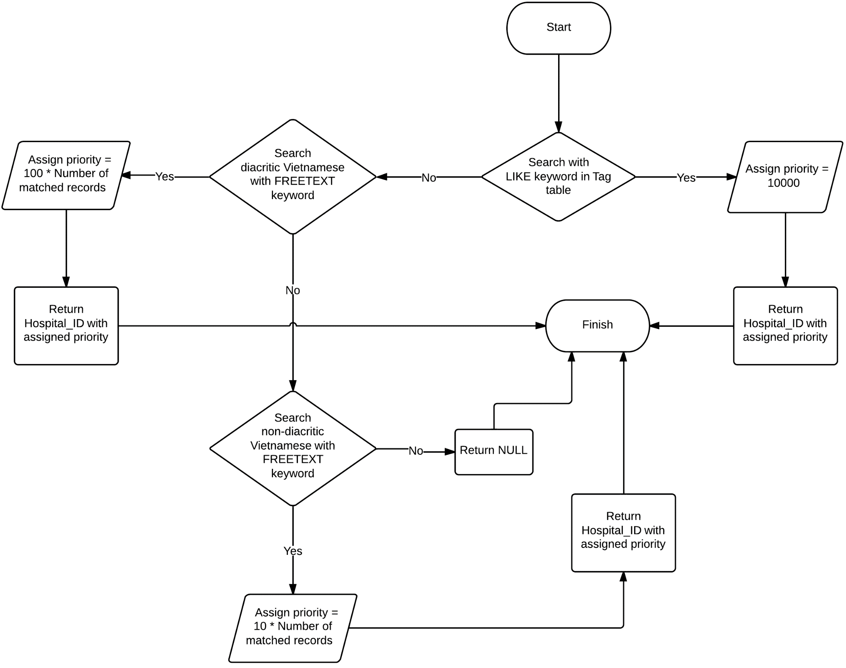
ALGORITHMS

Slide 14
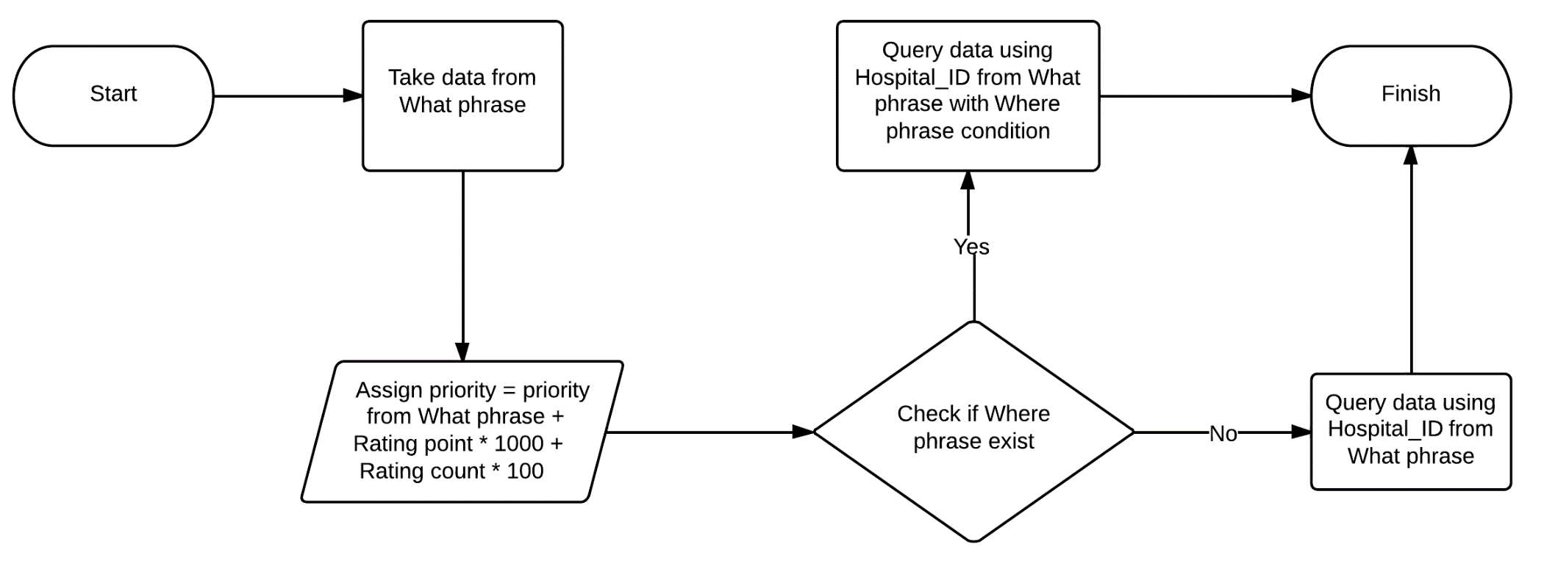

Slide 15
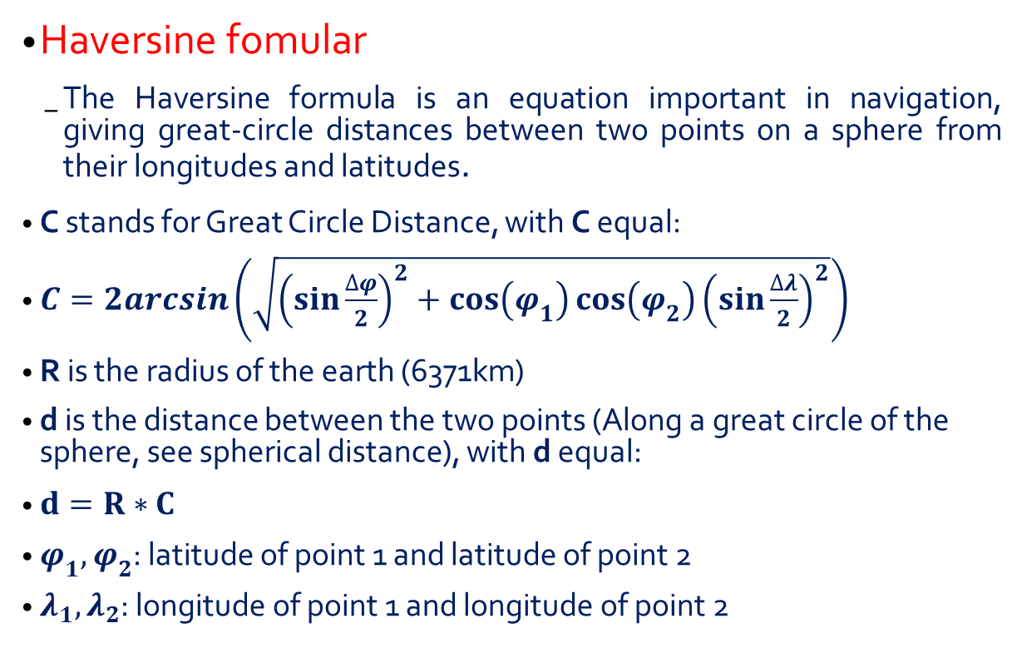
ALGORITHMS
Haversine fomular
The Haversine formula is an equation important in navigation, giving great-circle distances between two points on a sphere from their longitudes and latitudes.
C stands for Great Circle Distance, with C equal:
$C=2arcsin\left(\sqrt{{\left(\sin{\frac{∆φ}{2}}\right)}^{2}+\cos\left(φ_{1}\right)\cos\left(φ_{2}\right){\left(\sin{\frac{∆λ}{2}}\right)}^{2}}\right)$
R is the radius of the earth (6371km)
d is the distance between the two points (Along a great circle of the sphere, see spherical distance), with d equal:
$d=R∗C$
$φ_{1},φ_{2}$: latitude of point 1 and latitude of point 2
$λ_{1},λ_{2}$: longitude of point 1 and longitude of point 2

Slide 16
BOUNDARY
Only support services for guest on mobile version.
English and foreign language are not supported.
Auto detect tag keywords and search hospital base on alias name are not support in this version.
The system is not provide any services or methods to manage business of hospitals or clinics online.

Slide 17
FUTURE IMPROVEMENT
Support auto detecting Vietnamese tag keywords.
Support searching though alias name.

Slide 18
DEMO
Search hospitals using normal search
Search hospitals using advanced search
Search hospitals using location search
Import list of hospitals in District 12 and using search options to search
Manage information of hospitals
Manage information of meta data
Manage information of users

